Slide 1
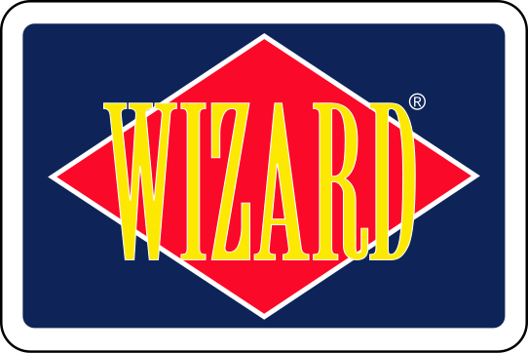
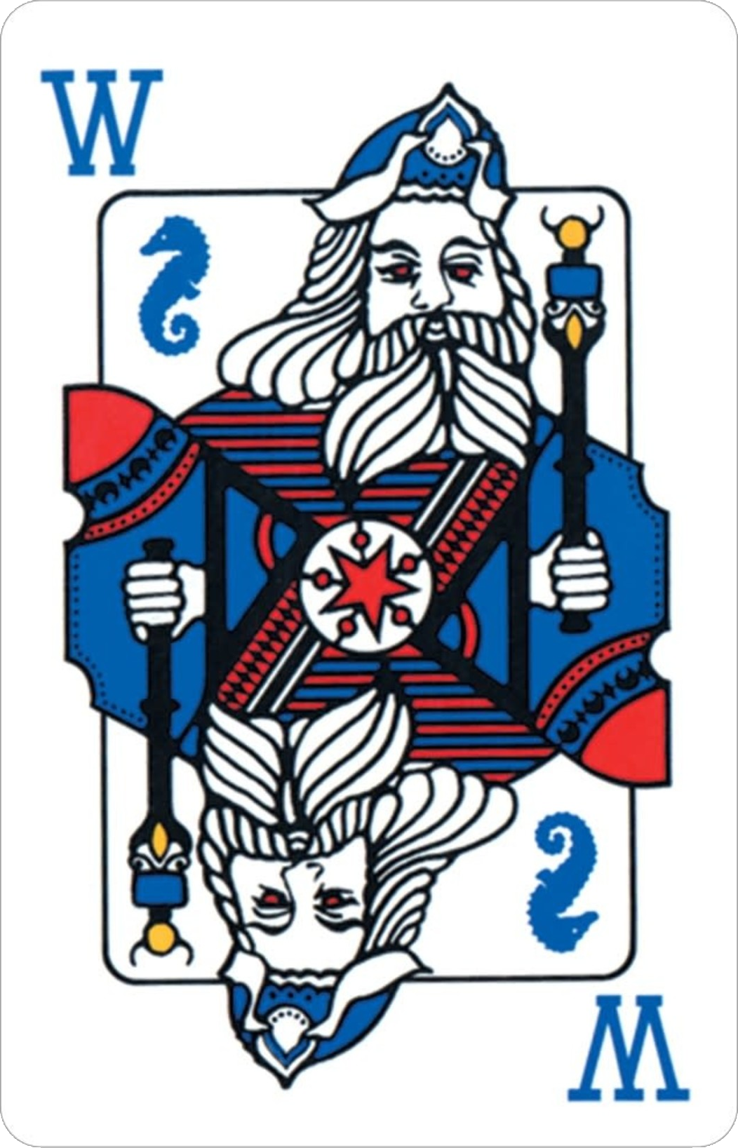
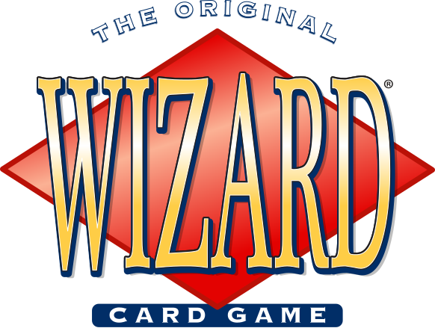
WIZARD AI Multi-Agent Training in
Roger Fowler

Slide 2
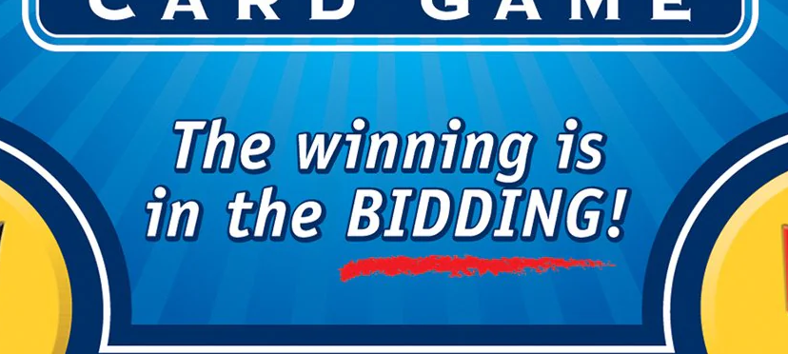
Game Description
Played with a 60 card deck: standard 52 + 4 Wizards and 4 Jesters
3-6 players, focusing on N = 4 for balance of gameplay qualities
Game: composed of 60 / N = 15 rounds
Round M:
Each player is dealt M cards
Each player bets how many of M tricks they will win
Tricks are played with the previous winner starting
Player only receives points for exactly matching bet and loses points otherwise
Challenges:
Stochastic state transitions due to other agent actions
Card values may change from trick to trick
Agents may force other agents to take actions

Slide 3
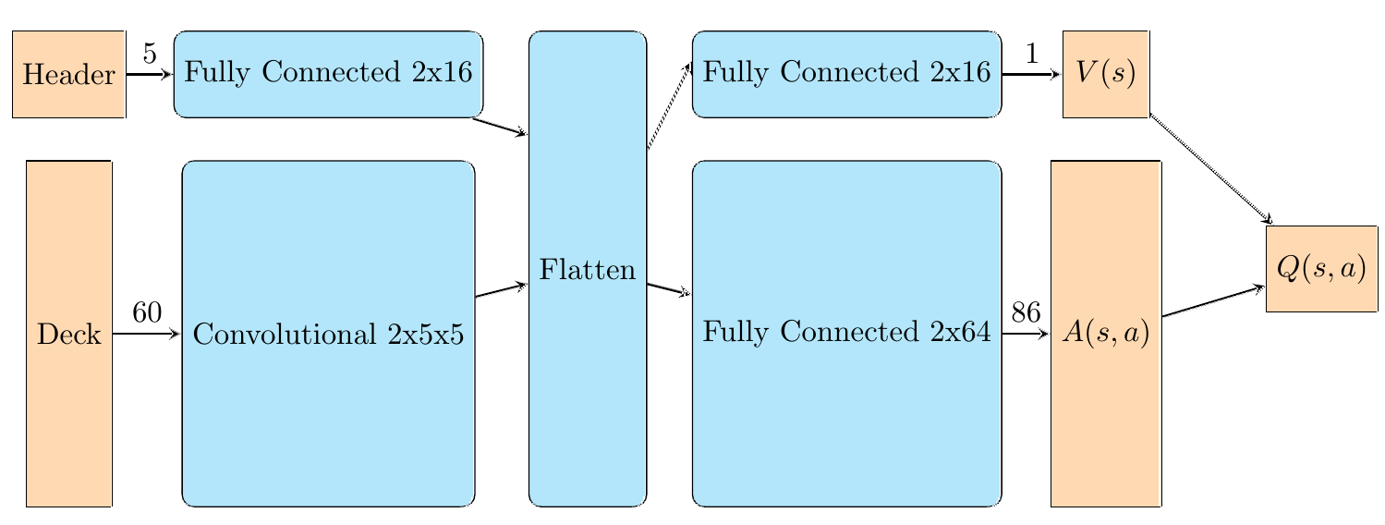
Approach & Architecture
Large state space (> 60!)
Requires neural network
Header (bets, players, suits)
Deck state (in hand, on table, seen)
Large action space (= 86)
60 cards, 21 bets, 4 suits, 1 terminal
Betting actions are very important
Replay Buffer prioritizes betting actions
DDQN stabilizes learning
Agents are pooled

Slide 4
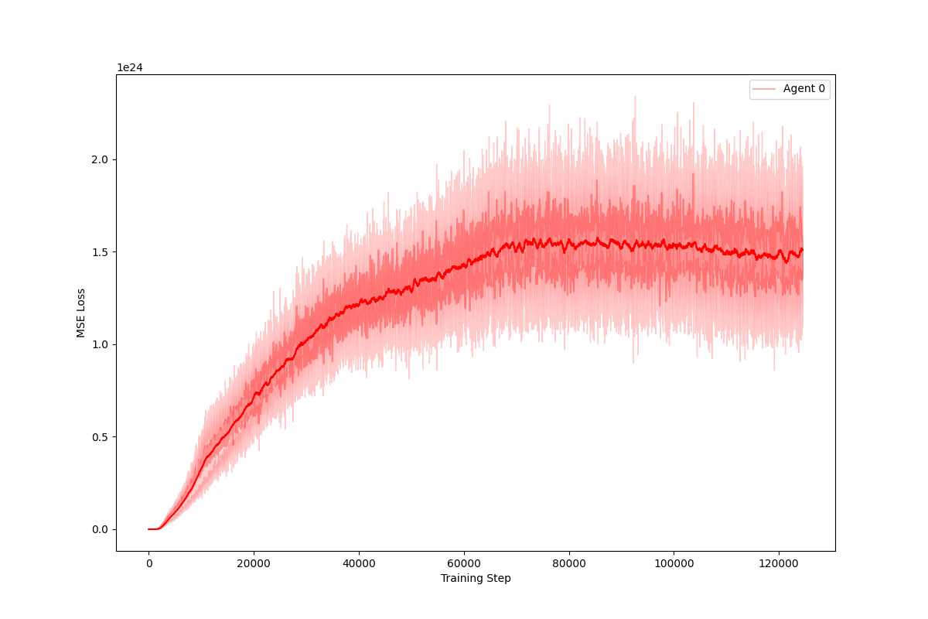
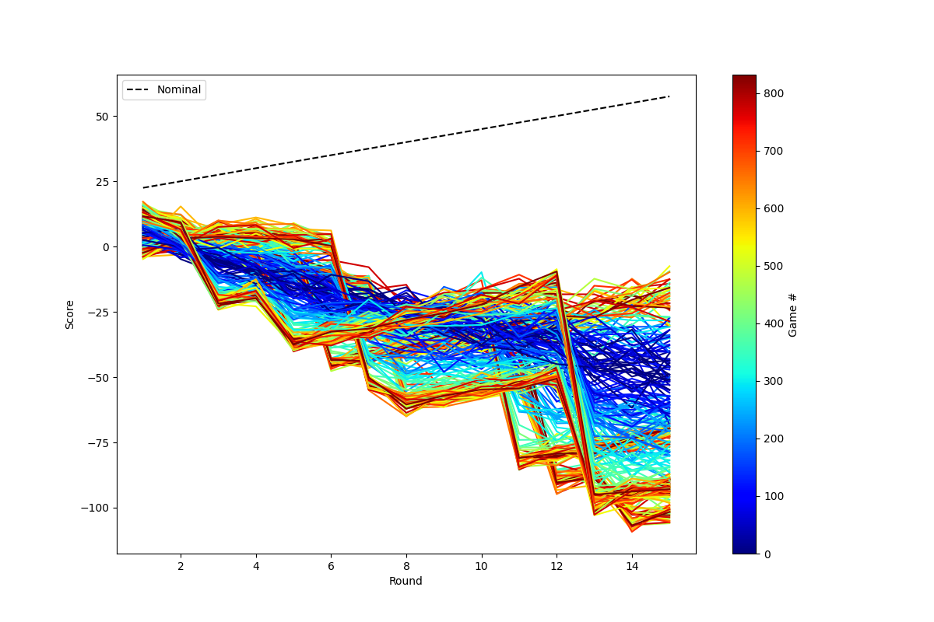
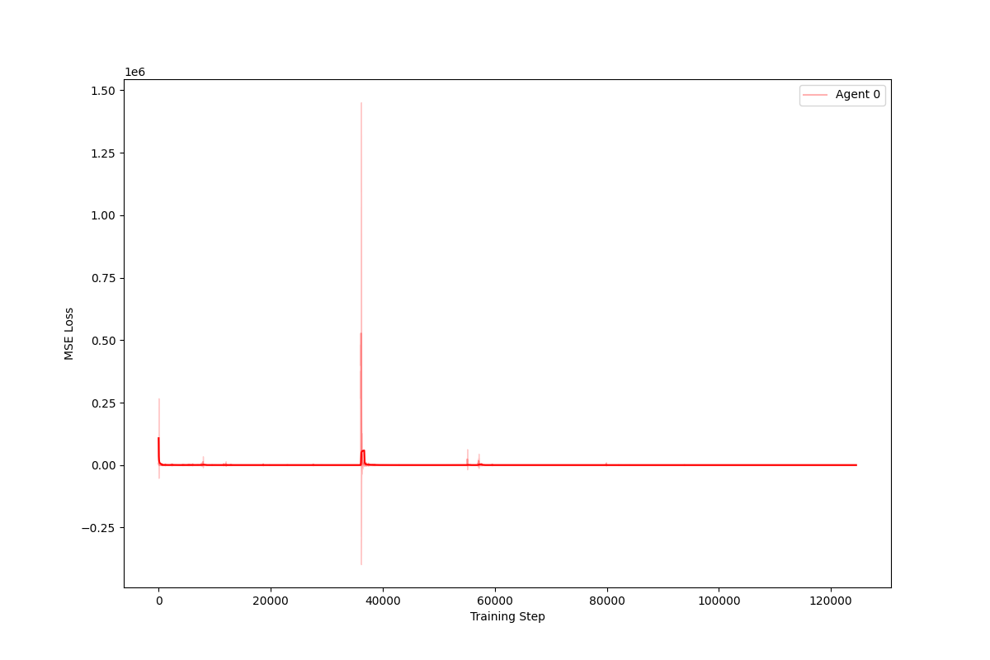
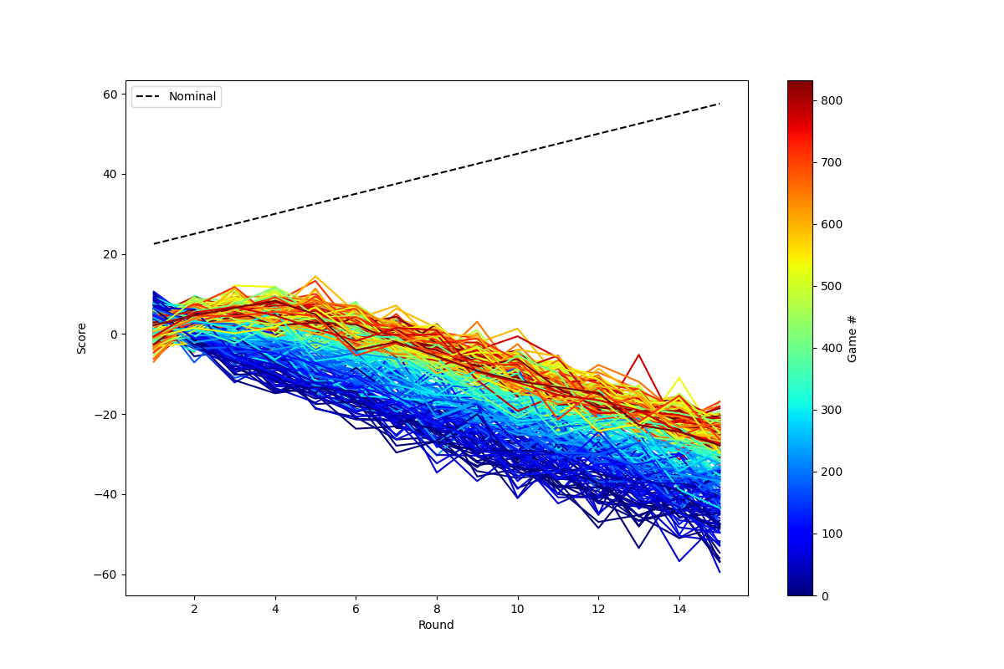
Progress & Results
Single largest difference is due to replay priority
With priority:
Consistent loss curve
Inconsistent performance
Without priority:
Inconsistent loss curve
Consistent performance
Demonstrates importance of betting

